Slide 1

G2M Case Study
Virtual Internship
16-Feb-2023

Slide 2
Background – G2M (cab industry) case study
XYZ is a private equity firm in US. Due to remarkable growth in the Cab Industry in last few years and multiple key players in the market, it is planning for an investment in Cab industry.
Objective : Provide actionable insights to help XYZ firm in identifying the right company for making investment.
The analysis has been divided into four parts:
Data Understanding
Finding the most profitable Cab company
Recommendations for investment
Forecasting profit

Slide 3
Data Understanding
19 Features
Timeframe of the data: 2016-01-31 to 2018-12-31
Total data points :359854
Assumptions:
Outliers are present in Price Charged and Profit features, but due to
unavailability of trip duration details and various consideration,
We do not deal with them
Profit is obtained by reducing the price charged and cost of trip
City.csv contains the population and cab users in each city, we did
not include it in the final data because it can be processed independently
without having to be combined
Cab_Data.csv
Customer_ID.csv
Transaction_ID.csv
US Holiday.csv
Used data
City.csv

Slide 4
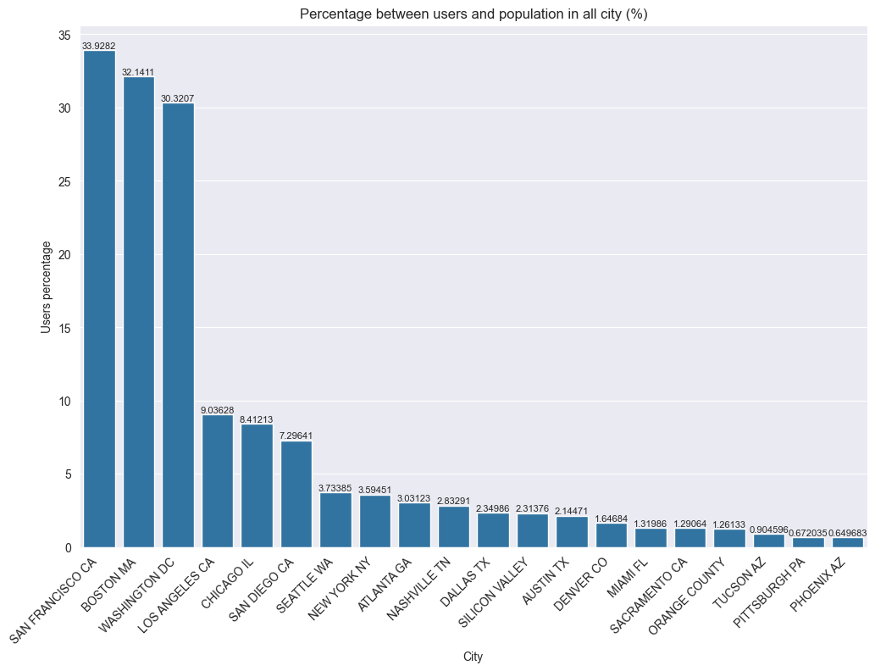
Profit Analysis
User Analysis
San Francisco, Boston, dan Washington DC have the highest percentage (more than 30%) of cab users out of the entire population.

Slide 5
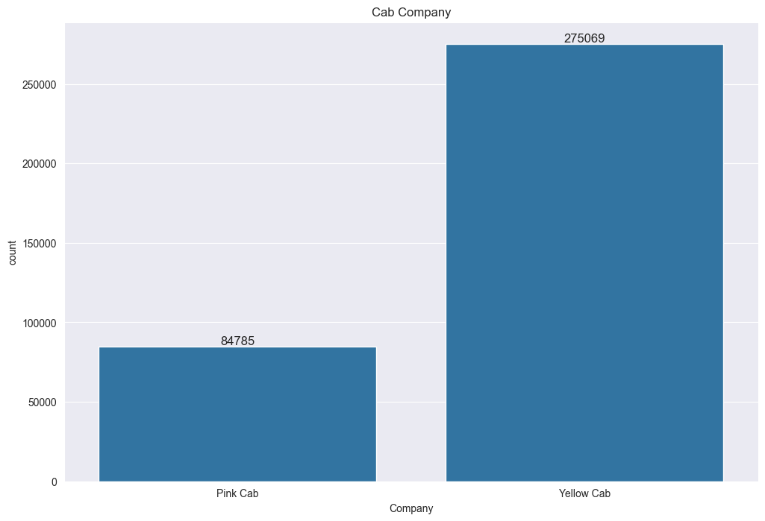
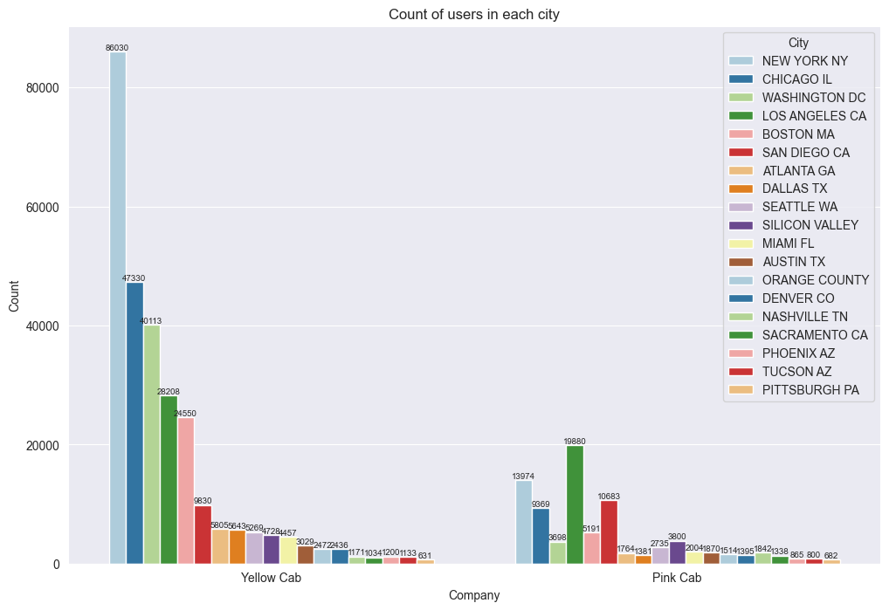
Profit Analysis
User Analysis
Yellow cab has more users than pink cab. Yellow cab has most users in New York city, while pink cab has most users in Los Angeles, the difference between the two is very visible drastically

Slide 6
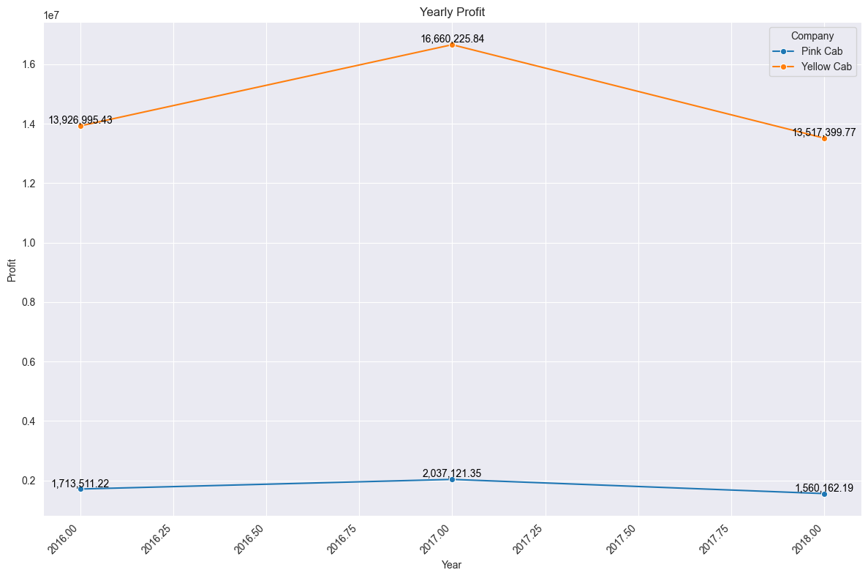
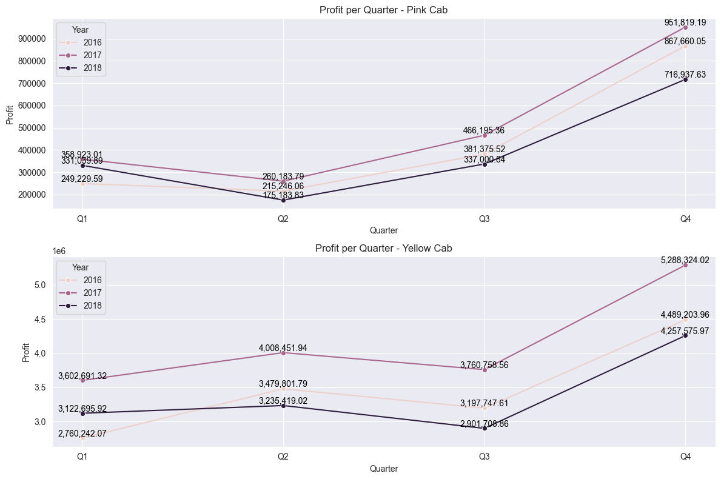
Profit Analysis
Profit Analysis - Yearly and Quarterly
Yellow cab has much more profit than Pink cab. Both companies had an increase in profit in 2017 and a decrease in 2018
Yellow cab experienced a decrease in profit every Q2, increased in Q3, and increased significantly in Q4, while pink cab experienced an increase in Q2, decreased in Q3, and increased significantly in Q4.

Slide 7
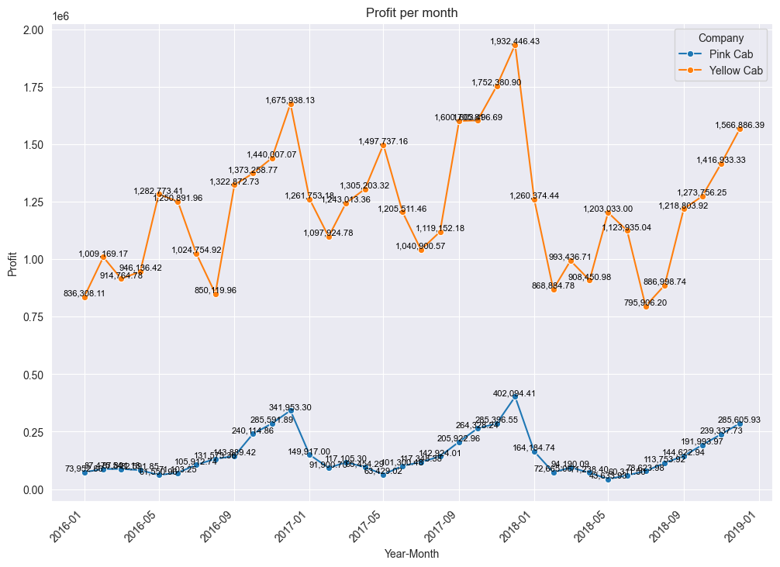
Profit Analysis
Profit Analysis - Monthly
The profits obtained by both companies in more detail. We recommend investing in Q2, which has the lowest prices

Slide 8
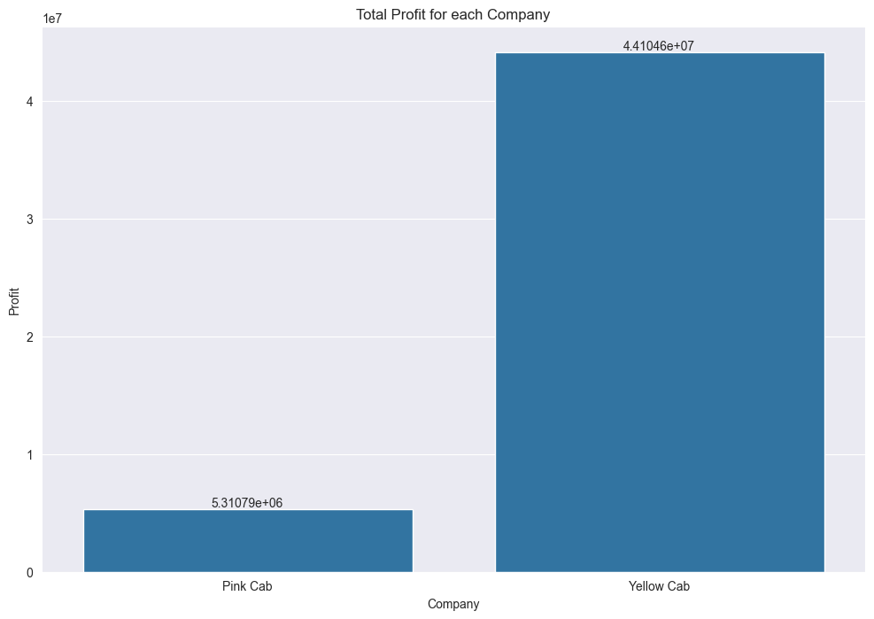
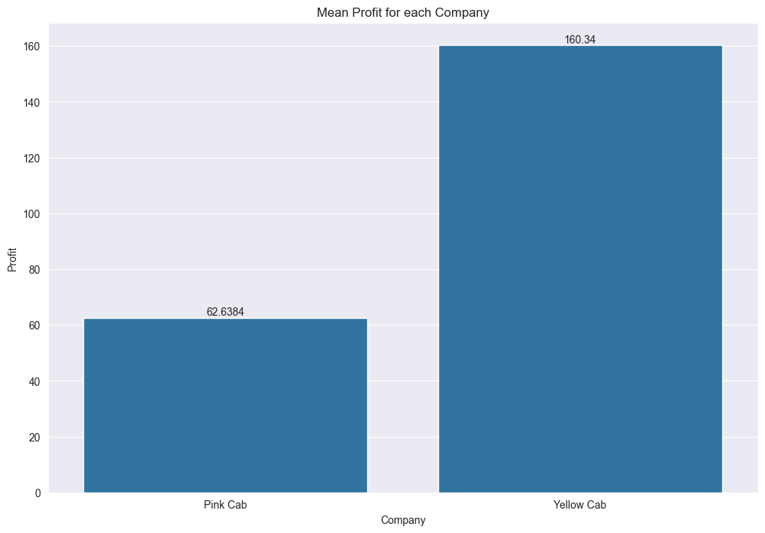
Profit Analysis
Profit Analysis - Total and Average
The profits earned by Yellow Cab are much higher than Pink Cab. Likewise with the average

Slide 9
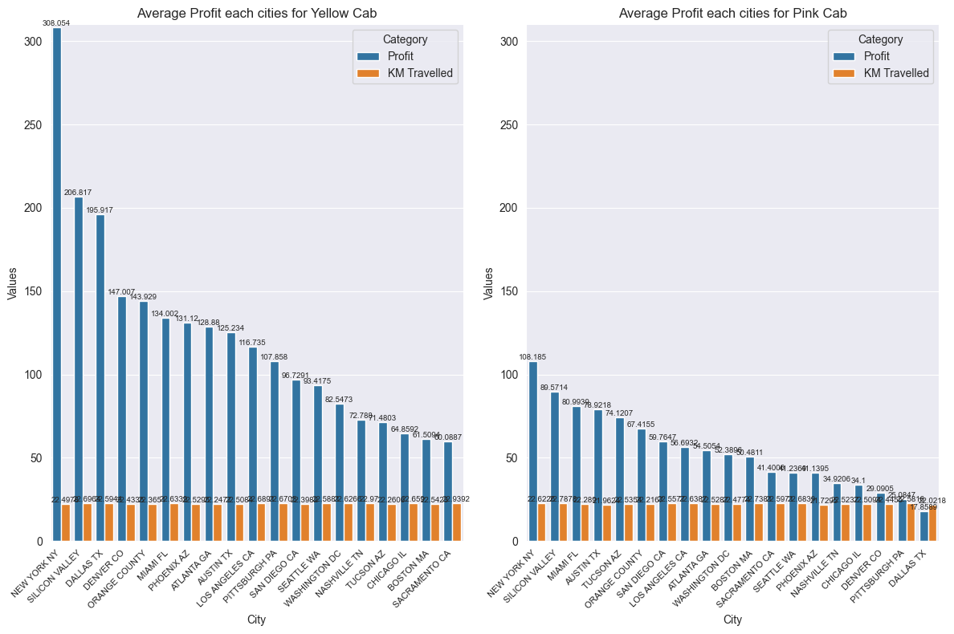
Profit Analysis
Profit Analysis - City
In terms of profitability, New York City stands out with the highest average profit among all cities. This suggests that individuals in New York City tend to pay comparatively more covering similar distances.

Slide 10
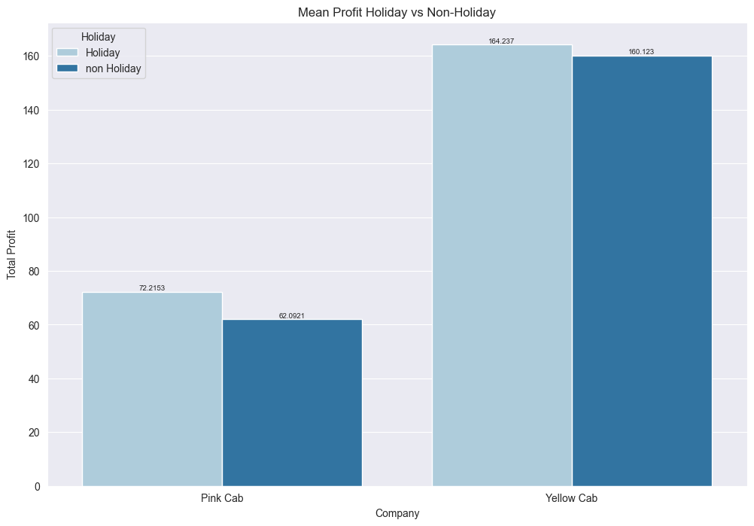
Profit Analysis
Profit Analysis - Holiday
Holidays provide more profit than non-holidays

Slide 11
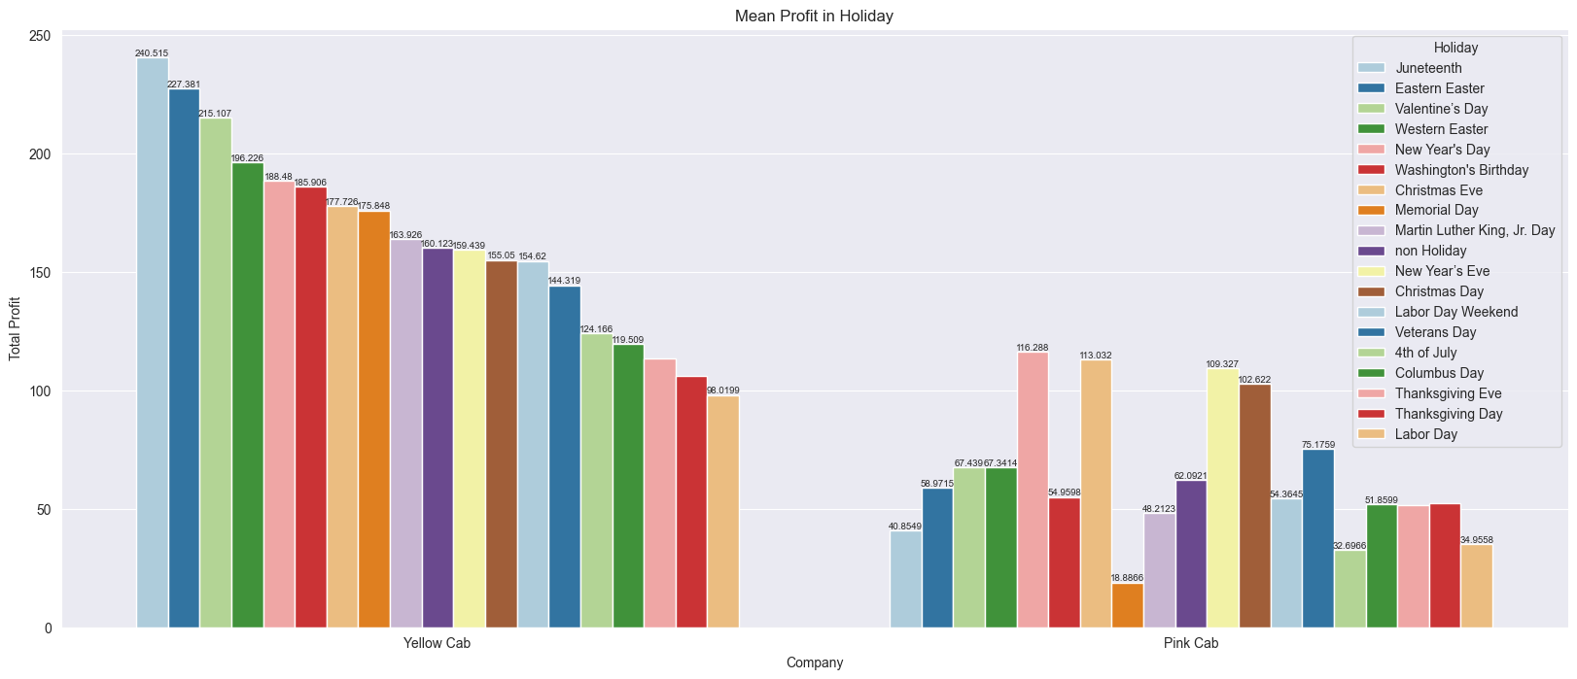
Profit Analysis
Profit Analysis – Holiday (more detailed)
Juneteenth, Eastern Easter and Valentine's Day are the biggest contributors to profit during holidays for Yellow Cab
New Year's Day, Christmas Eve and New Year's Eve are the biggest contributors to profits during holidays for Pink Cab

Slide 12
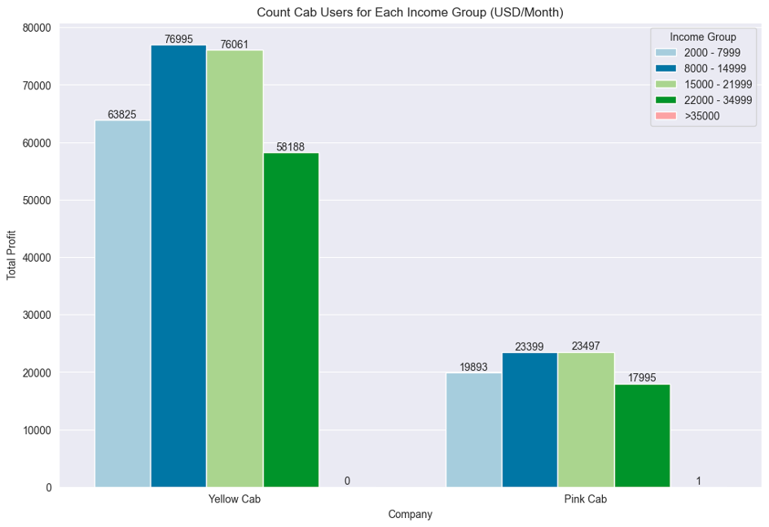
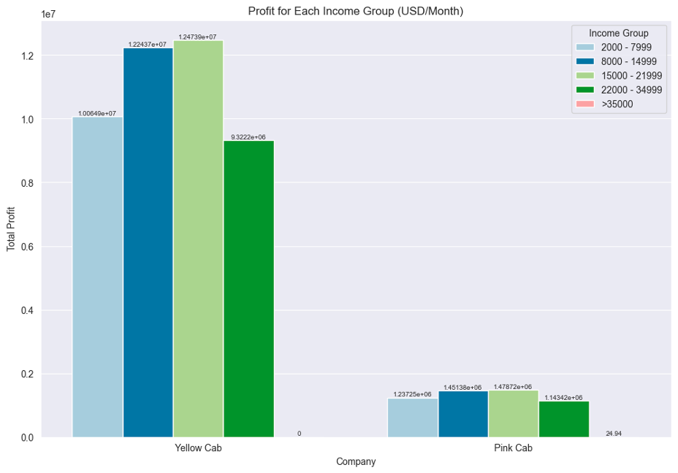
Profit Analysis
Profit Analysis – Income
Income of 8000 - 21999 USD provides the most profit for both companies.

Slide 13
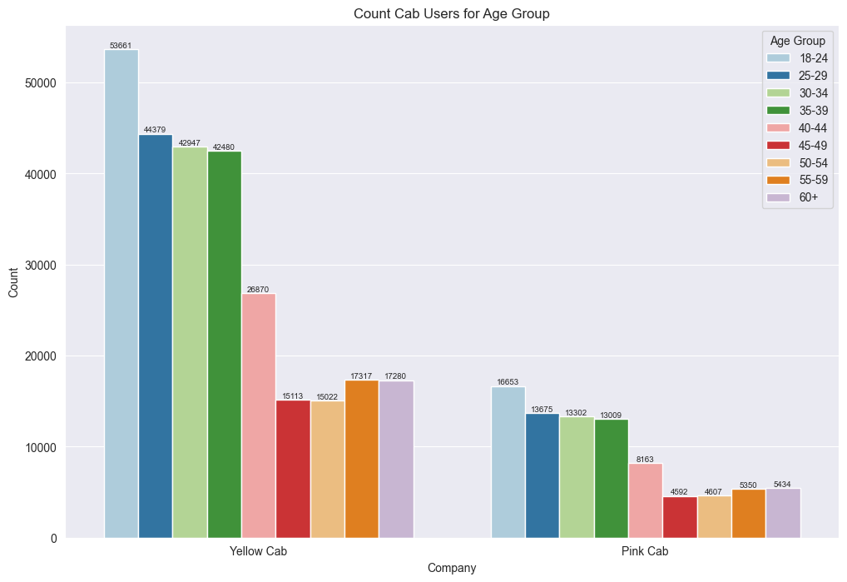
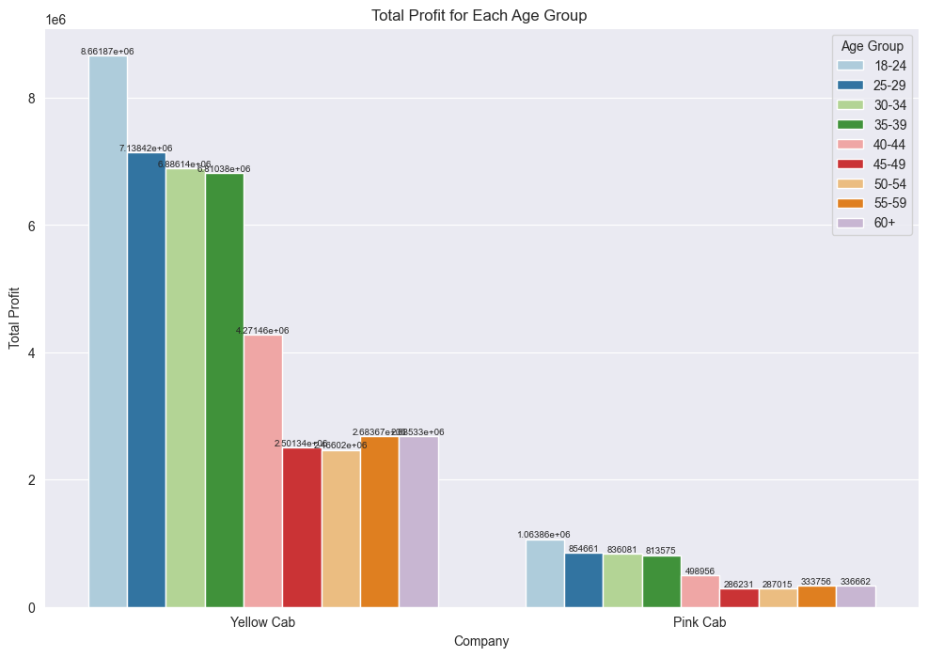
Profit Analysis
Profit Analysis – Age
18-24 year old are the largest users and the largest contributors to profits for both companies

Slide 14
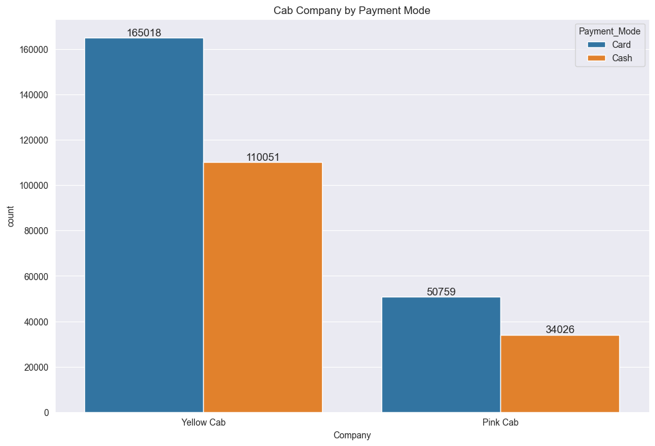
Profit Analysis
Payment Mode
The majority of users from both companies prefer to pay using card.

Slide 15
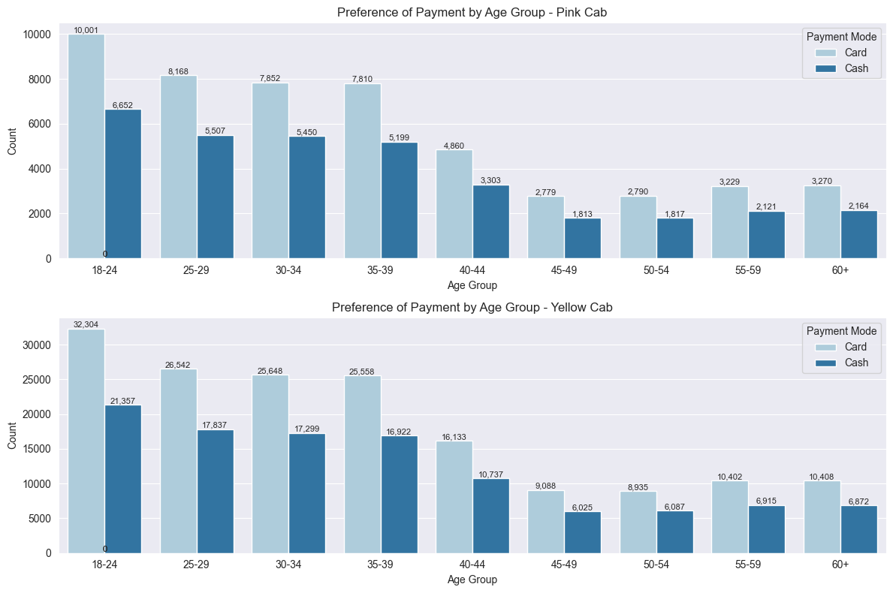
Profit Analysis
Payment Mode – Age Group
For all age groups across both companies, the preferred method of payment is through card transactions.

Slide 16
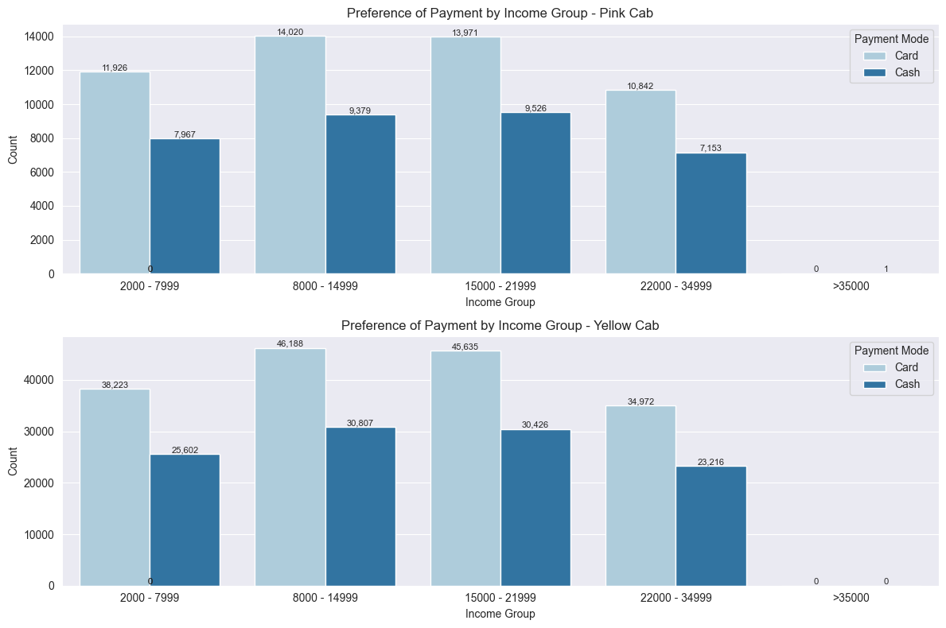
Profit Analysis
Payment Mode – Income Group
For all income groups in both companies, the preferred payment method is also card transactions.

Slide 17
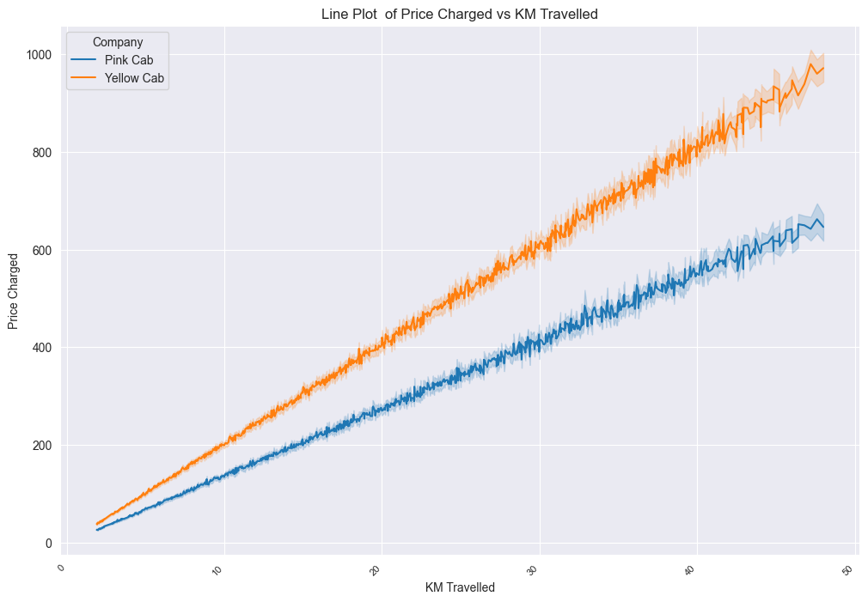
Profit Analysis
Relationship of Price vs KM Traveled
The higher distance traveled, the higher the price charged.

Slide 18
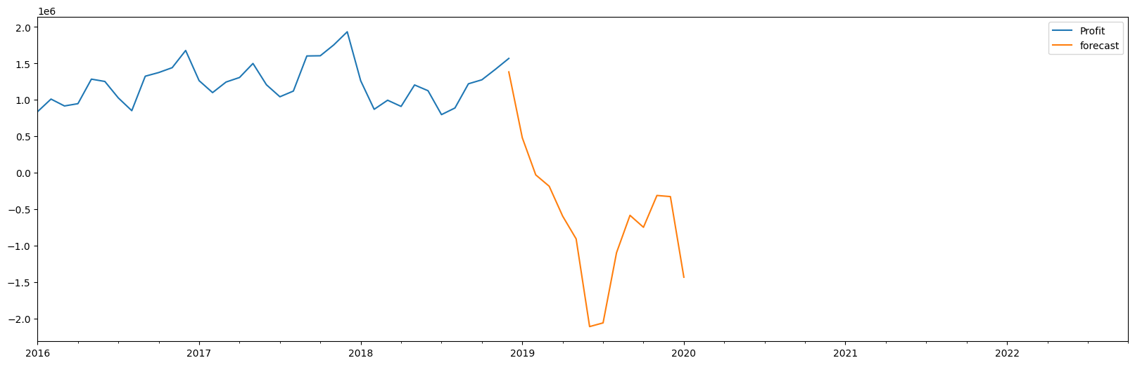
Profit Analysis
Profit Forecasting in 2019

Slide 19
Recommendations
We have carried out an analysis of both companies and found the facts:
Yellow cab has more users in all cities than pink cab
Yellow cab have higher total profits and average profits than pink cab in all fields (city, holidays, income and age)
Users of all ages and incomes preferred making payments using cards over cash for both companies
Yellow cab has a higher price charged for each KM of distance
From the description above, we recommend Yellow Cab for investment
Profit Forecasting : Both the companies are facing loss in the profit and no. of ride. Yellow cab’s forecasted profit loss is around 1.83% while Pink cab’s loss in 3.1%.Pink cab is facing more loss even when its forecasted no of ride loss is lesser than Yellow cab.

Slide 20

Thank You

